Slide 1
Presidential Succession and the Vice Presidency (Section 2)

Slide 2
Presidential Succession
Presidential succession is the plan for fulfilling a presidential vacancy.
The first time this happened was in 1841: John Tyler (William Henry Harrison’s VP) took office when the President died of pneumonia.
Only 1 month after taking office.
The 25th amendment made this official.

Slide 3
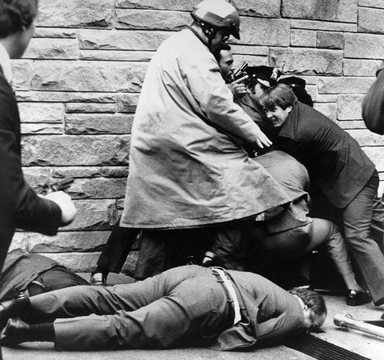
Presidential Disability
What is the president is too sick to do his job?
The 25th amendment also included a provision that allowed for the VP to take over if the president wrote to congress explaining he could not do his job.
This would also happen if the Vice President and the majority of the Cabinet wrote to congress explaining the same thing.

Slide 4
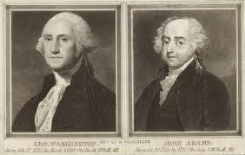
The Vice President
“I am Vice President. In this I am nothing, but I may be everything.” –John Adams (the first VP)
Two Formal Duties:
Preside over the Senate as the President of the Senate.
Helps decide the question of Presidential disability.
(the President in waiting)

Slide 5
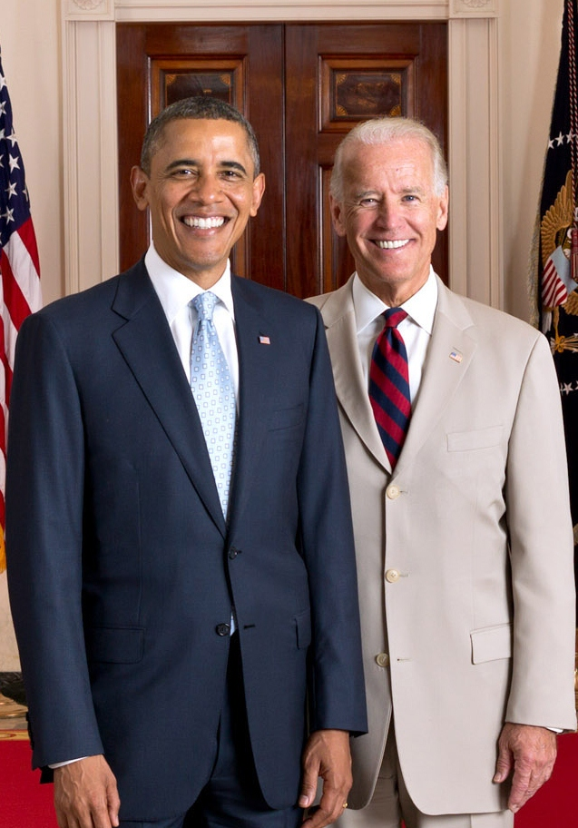
“Balancing the Ticket”
The president attempts to choose a running mate who will strengthen their chance of winning the presidency.
They might think of characteristics like:
Beliefs
Gender
Race
Ethnicity

Slide 6
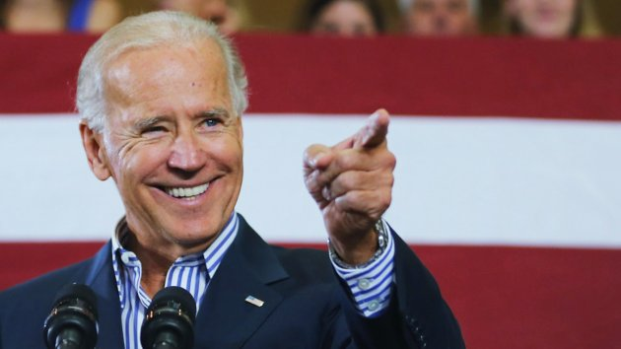
Vice President Today
Recently, Presidents have made greater use of their VPs.
Dick Cheney and Joe Biden have been influential in office.
The VP is not subject to removal from office by the President, which might be one reason the VP has never been considered a true “Assistant President”

