Slide 1
The Supreme Court
Judicial Branch

Slide 2
Supreme Court
Our court of last resort
Has final say on any case involving the US Constitution, acts of Congress, and treaties with other nations.
Has original jurisdiction over cases where a STATE is a party and when there is a foreign ambassador involved.

Slide 3
Cases
The Supreme Court sets its ________________________.
It only hears cases it decides to hear, usually a few hundred per congressional session.
Over 8,000 cases were submitted to the court this year.

Slide 4
Cases
Cases can get to the Supreme Court through….
Writ of Certiorari: when the Supreme Court directs a lower court to send the record of the case.
By Certificate: The lower court asks the Supreme Court to consider the case.

Slide 5
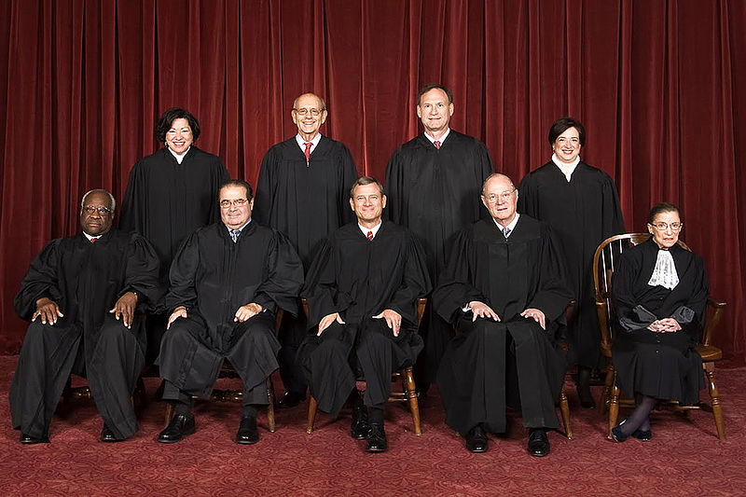
Supreme Court Justice
Supreme court has 9 justices.
One Chief Justice
8 Associate Justices

Slide 6
Justice History
Throughout the court’s history more than 100 men and 4 women served on the Supreme Court
Two Black Men
Thurgood Marshall
Clarence Thomas
Four Women
Sandra Day O’Connor
Ruth Bader Ginsberg
Elena Kagan
Sonia Sotomayor

Slide 7
Policy Shaping
The Supreme Court shapes United States policies through:
Judicial Review
Interpreting laws
Over-ruling or reversing previous laws

Slide 8
Marbury V. Madison
This case arose in the aftermath of a stormy election.
When Jefferson won a new party rose to power.
The current president tried to pack the courts with people from his party.
The papers for these new judges were not delivered and when Jefferson took office he ordered them never to be delivered.

Slide 9
Marbury V. Madison
Marbury took Jefferson’s Secretary of State (Madison) to court for not delivering the commissions for the federal judges.
The Supreme Court refused Marbury’s request, laying the foundation for Judicial Review.
This was the first time they declared an act of Congress Unconstitutional

Slide 10
Judicial REview
First time the Supreme Court used judicial review: Marbury v. Madison in 1803
Judicial Review: the power of the supreme court to declare an act of Congress unconstitutional
This means the supreme court has the final say on the interpretation of the constitution.
http://www.youtube.com/watch?v=3TVkeRUvX_U

Slide 11
Judicial Review and States
The supreme court often applies Judicial Review to courts involving state and local laws.
This can affect federal laws as well.
Ex. Brown v. Board of Education
http://www.youtube.com/watch?v=TTGHLdr-iak

Slide 12
Judicial Review
What famous chief justice established JUDICIAL REVIEW expanding the power of the Judicial Branch?
What famous court case led to this establishment?

