Slide 1
The Federal Court System

Slide 2
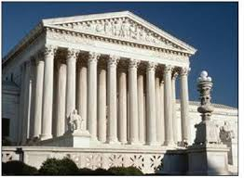
Judicial Power
“The judicial power of the United States shall be vested in on supreme court, and in such inferior courts as the Congress may from time to time ordain and establish.”
Judicial power is held by_______________________.
Congress may establish________________________.

Slide 3
Federalism
What is federalism?
This applies to our court systems.
We have 2 court systems in our nation.
The National/Federal Court System
The State Court System

Slide 4
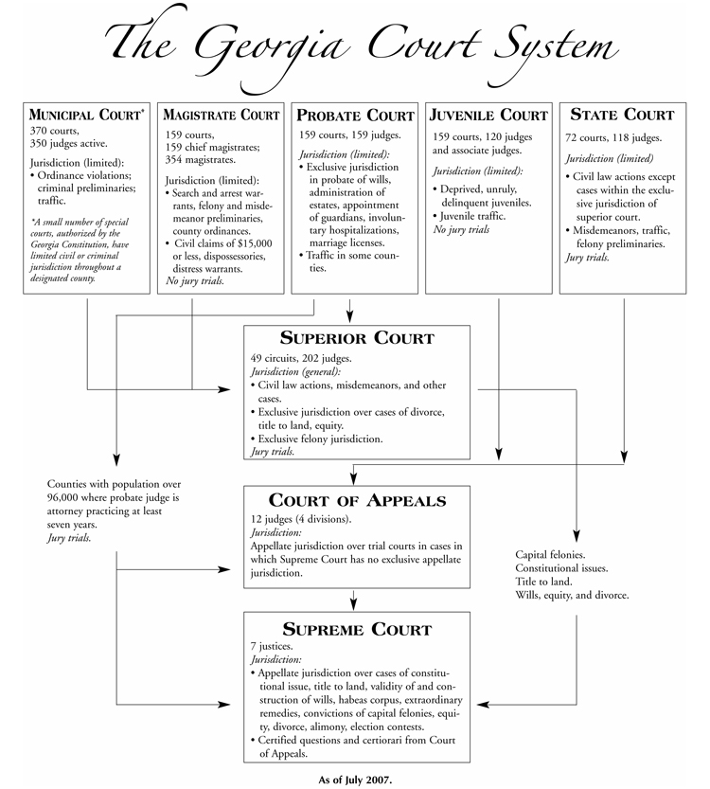

Slide 5
Federal Courts
The Supreme Court is created by the constitution.
Congress can create inferior courts, which are all of the courts beneath the Supreme Court.
Congress has created two types of courts:
The Constitutional Courts
The Special Courts

Slide 6
The Constitutional Courts
These courts exercise the Judicial Power of the United States.
This includes: The Courts of Appeal, The District Courts, and the US Court of International Trade
These courts are also known as regular courts or Article III courts.

Slide 8
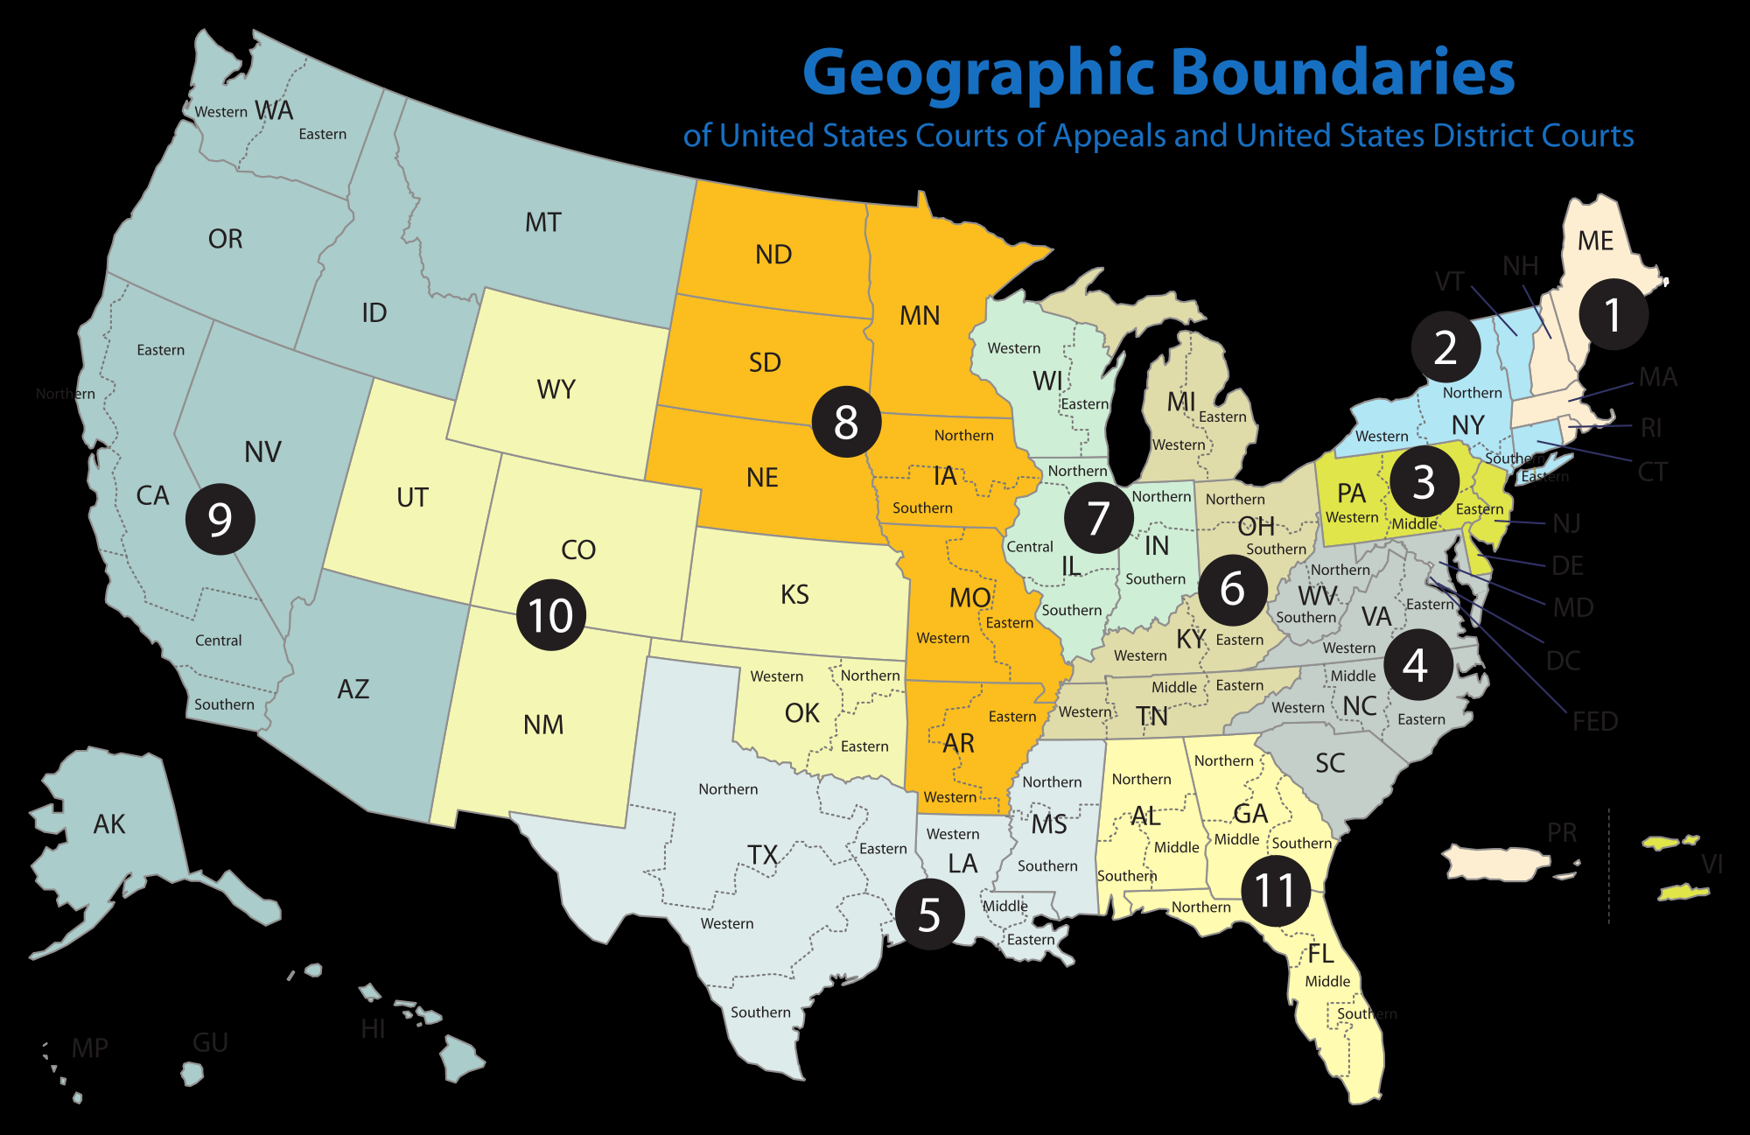

Slide 9
The Special Courts
These courts do not exercise judicial power.
They help Congress exercise Article I powers
Give an example of a few in your notes:
US Court of Federal Claims
US Tax Court
Territorial Courts
US Court of Appeals for the Armed Forces
Courts of the District of Columbia
US Court of Appeals for Veteram Affairs

Slide 10
Federal Jurisdiction
Jurisdiction: the authority of a court to hear (to try and to decide ) a case.
The Federal Courts have limited jurisdiction (they can only hear certain cases).
A case the involves interpreting the Constitution (Especially the Bill of Rights)
A case that involves Admiralty/Maritime Law
This means it happened at sea.
A case that involves a federal official.
A case that involves an ambassador (representative from another nation).
A case that involves more than one state.

Slide 11
Exclusive vs. concurrent
If the federal courts have exclusive jurisdiction this means a case can ONLY be tried in a federal court.
If the federal courts have concurrent jurisdiction the state courts and federal courts share jurisdiction.
Disputes between people from two difference states can be concurrent.
Federal courts usually only hear the case if it involves more than 75,000 dollars
Original Jurisdiction: the authority to hear the case first
Appellate Jurisdiction: a court that hears appeals from original courts

Slide 12
Judges
The President can appoint federal judges and the Senate must approve the appointments.
They serve for life (unless they retire, resign, or die).
7 have been impeached and removed from office.
Something that impacts the selection process of judges is whether or not the judge shows Judicial Activism or Judicial Restraint.

Slide 13
Judicial Restraint Judicial Activism
Supporter believe that the Judge should decide on cases based on the original intent of the Framers of the Constitution.
They do not believe Judges should make decisions that change laws or the way society functions.
They believe that creating laws should only fall within the Legislative Branch.
Supporters of activism give Judges more power.
They believe that decisions should be made based on changes in society.
You often see this in cases involving civil rights or welfare.

Slide 14
Quick Quiz: Use your notes and pages 520-527 in your book. Separate Sheet Of paper
What are the two types of court systems in our nation?
What are the constitutional courts?
What are the type of cases a Federal Court system can hear?
What is the difference between concurrent and exclusive jurisdiction?
What is the difference original and appellate jurisdiction?
What is the difference between judicial restraint and judicial activism

