Slide 1
The Declaration of Independence

Slide 2
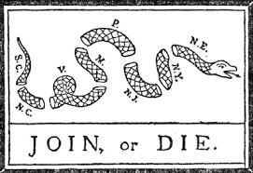
Working Towards Independence…
The colonists needed to unite to become independent of Britain.
An early plan was called the Albany Plan of Union.
Proposed by Benjamin Franklin
A yearly meeting of representatives from each of the 13 colonies
Raise taxes, fight Native Americans, raise militaries.
This plan was turned down by the Crown.

Slide 3
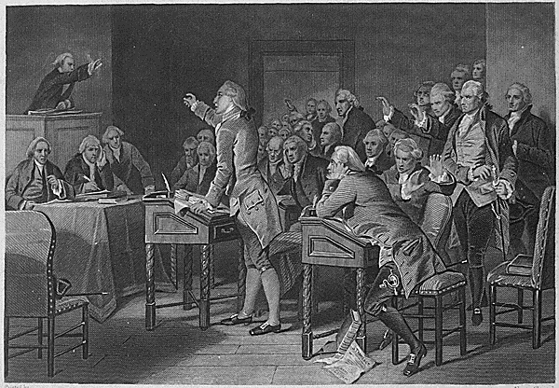
Stamp Act Congress
The colonists resented the British because of taxes.
They considered the Stamp Tax too severe but mainly because of “taxation without representation”.
9 colonies sent representatives to New York, known as the Stamp Act Congress.
This was the first time a large number of colonists met to oppose the King.

Slide 4
First Continental Congress
The British passed laws which became known as the Intolerable Acts.
This time delegates from EVERY colony EXCEPT Georgia met in Philadelphia.
They met for months and sent a “Declaration of Rights” to the Crown.
Boycotted British goods
Refused to trade

Slide 5
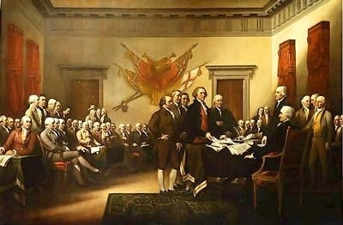
2nd Continental Congress
The British reacted to the “Declaration of Rights” by taking stricter measures with the colonists.
By the time this congress met the war had begun.
All 13 colonies were present at this congress.
George Washington was appointed head of the continental army.
This is considered the first government of the United States (even without a constitution).

Slide 6
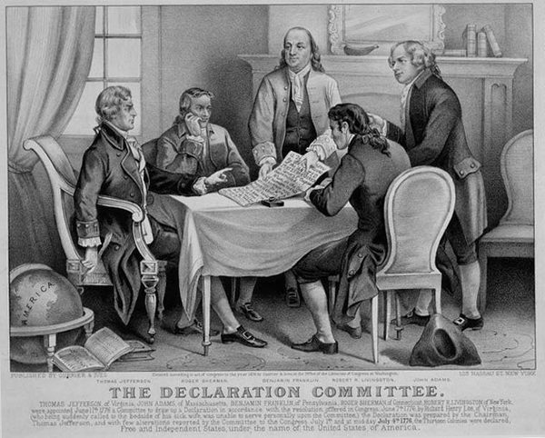
Declaration of Independence!
Richard Henry Lee proposed to the 2nd Continental Congress that we declare ourselves independent from England.
The Congress formed a committee of 5 to prepare the proclamation: Benjamin Franklin, John Adams, Robert Livingston, Roger Sherman, and Thomas Jefferson.

Slide 7
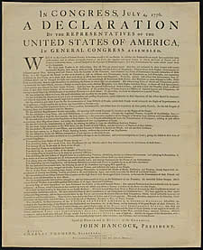
Declaration of Independence
After a long debate, the Declaration was adopted: July 4, 1776.
This was the first political system to be created based on the fact that PEOPLE should rule the government. The government exists due to the CONSENT of the people.

Slide 8
Primary Source:
“We hold these truths to be self-evident, that all men are created equal, that they are endowed by their Creator with certain unalienable Rights, that among these are Life, Liberty and the pursuit of Happiness. — That to secure these rights, Governments are instituted among Men, deriving their just powers from the consent of the governed, — That whenever any Form of Government becomes destructive of these ends, it is the Right of the People to alter or to abolish it, and to institute new Government, laying its foundation on such principles and organizing its powers in such form, as to them shall seem most likely to effect their Safety and Happiness.”

