Slide 1
Presidential Elections
Chapter 13 (Section 3-4)

Slide 2
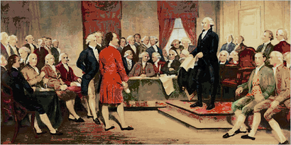
The Framers
Against Congress selecting the President
How would this interfere with Checks and Balances?
Against a direct vote by the people
Why?
Decided the President should be chosen by a set of Presidential electors

Slide 3
The Electoral College
The Electoral College is the group of electors chosen from each state and D.C. to elect the President/VP
Originally, the VP was the runner up.
When did this truly become problematic?

Slide 4
Presidential Primaries
Republicans and Democrats in each state play a role in choosing who will run in their party for the White House.
Two Options:
1. Voters can choose delegates from their party to vote for a Presidential candidate in their party during the National Convention
2. Voters can choose a candidate to represent their party in the race.
Delegates to the national convention can also be selected by a caucus (closed meeting of party members to choose delegates).

Slide 5
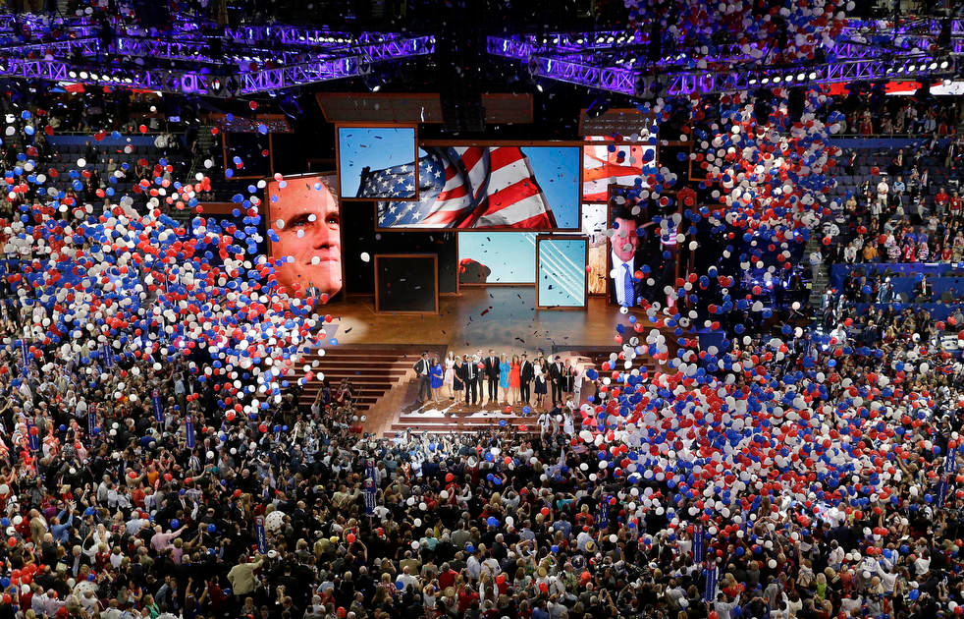
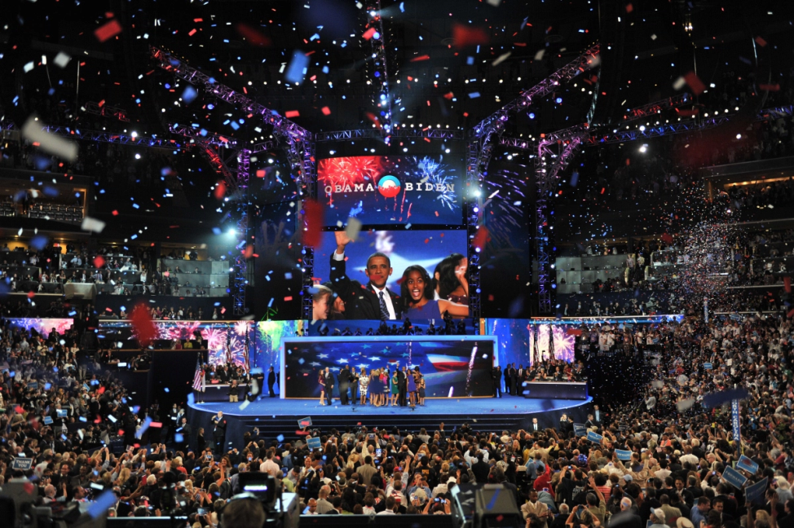
National Convention
The Democratic Committee and Republican Committees decide where their party convention will be held. Major cities bid for the honor.
Delegates from each state are sent to select to presidential candidates for their party.
Platforms are adopted
2012: GOP Convention was in Tampa Bay and the Democrats were in Charolette, NC

Slide 6
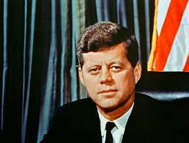
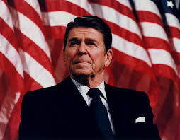
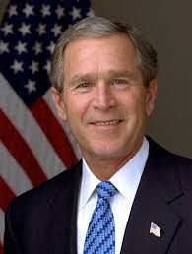
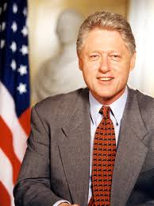
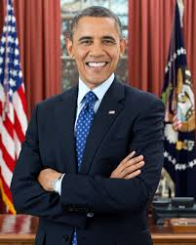
Informal Qualifications for Nominations
Political Experience
Military Experience
Well-spoken
Nice looking
Protestant
Married

Slide 7
Campaign
Campaigning used to begin after the National Conventions but today campaigns begin before.
Presidents focus their effort on swing states. (states known to get back and forth between voting democratic/republican)
A series of Presidential debates occur during this time.

Slide 8
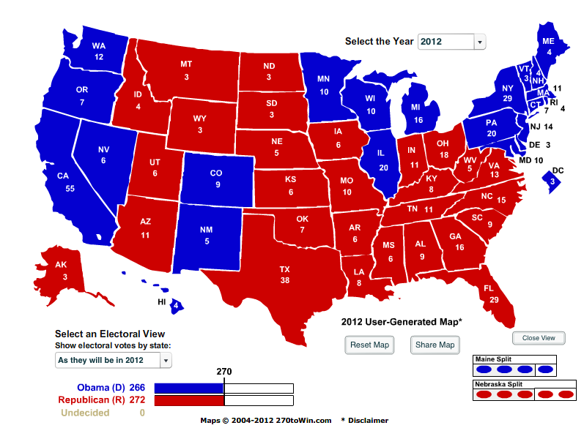
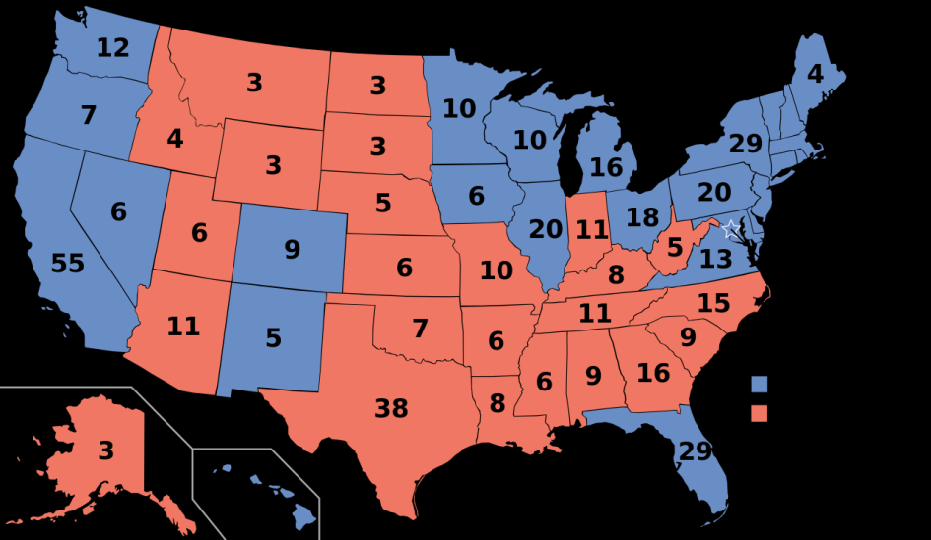
The Vote
People head to the polls to cast the “popular vote”. First Tuesday of November, every 4 years.
November 8, 2016
Winner-take all system in most states.
Presidential electors see how their state voted and candidate with the most votes gets 100% of the electoral votes in that state.
December

Slide 9
GAME BOARD: Road to the White House
Concepts:
Fundraising
Popular Vote
ELECTED PRESIDENT!
Republican and Democratic Nominations
National Convention
Primaries and Caucuses
Presidential Debate
Party Platform chosen
Presidential Campaigns
Electoral Votes
Title your paper “ROAD TO THE WHITE HOUSE” make this bold for display.
Using your notes and your book put the 10 steps in order from first to last!
Be creative!
Add color!
Describe the importance of each step and give each step details. Use your book and notes to add details.
PAGE 377

