Slide 1
Powers of Congress
Bell Ringer: Give two examples of POWERS OF CONGRESS:

Slide 2
Delegated Powers
Congressional powers are delegated (given) by the Constitution.
These delegated powers are either
1.) Expressed
2.)Implied or
3.) Inherent

Slide 3
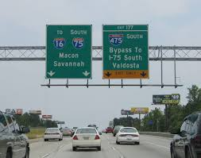
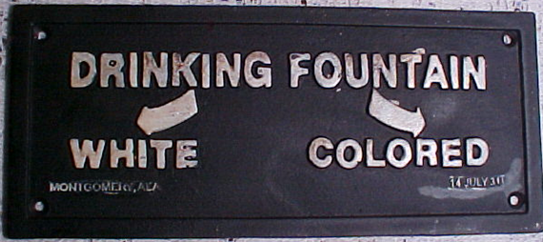
Expressed Powers
Commerce Power
Congress has the power to “regulate commerce with foreign nations, and among the several states, and Indian tribes.”
Make laws about BUSINESS
Commerce=the buying and selling of goods and services
Gibbons v. Ogden, 1824 expanded Congress’ commerce power. Regulated steam boat monopolies in New York.
Our interstates are an example of Congress’ Commerce power.
Even the Civil Rights Act of 1964 was connected to the Commerce Power.

Slide 4
Expressed Powers
Power to Tax
Borrowing Power
2014: The Federal government took in a record 3 trillion dollars in taxes!
Tax: a government charge on property to raise money for public needs.
Congress can not lay a tax on church services, voting, or exports.
There is no limit on the amount of money Congress can borrow.
The Public Debt: all the money borrowed by the Federal Government and not paid back
$18,200,000,000!
Per tax payer: $154,161

Slide 5
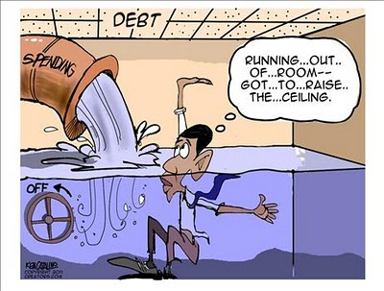
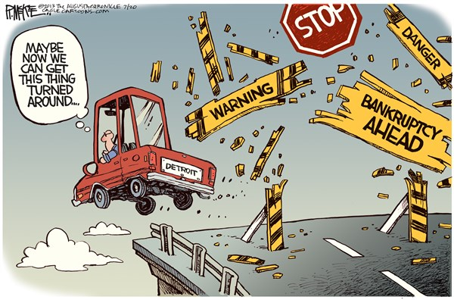
Expressed Powers
Bankruptcy Powers
Congress establishes Bankruptcy laws.
Bankruptcy is when a person can not pay their debts in full
Currency Powers
Congress has the power to coin money.

Slide 6
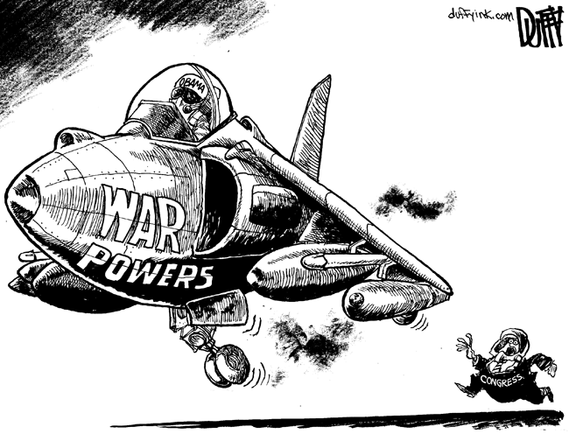
Expressed Powers
Only Congress can declare war.
This power is shared with the president since he is the commander in chief of our army.
Congress can create copyrights and patents.
Copyrights: the right for an artist to produce and sell creative works.
Patent: grants a person the sole right to produce and sell an item.

Slide 7
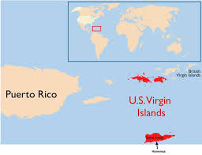
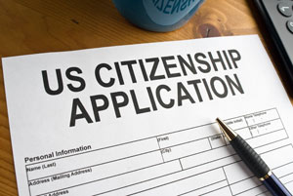
Expressed Powers
Congress establishes Post Offices
Carrying mail is one of the oldest government functions.
Congress can create and manage federal areas.
District of Columbia, US Territories (Guam, Puerto Rico, Virgin Islands)
Congress can create laws regarding naturalization

Slide 8
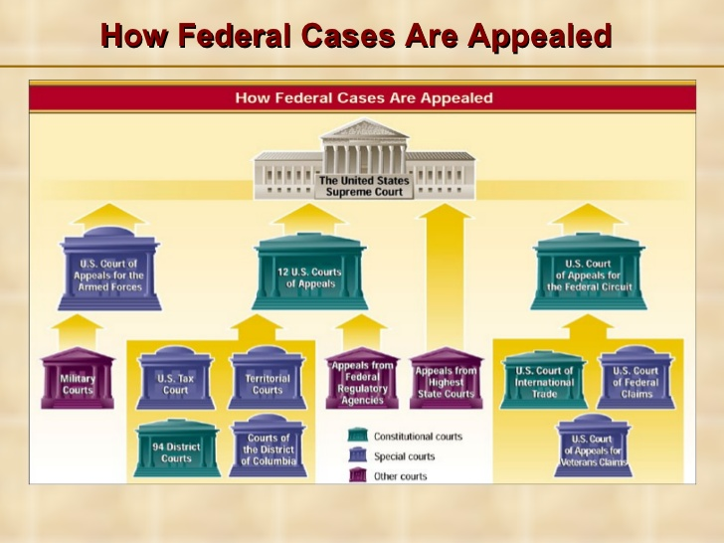
Expressed Powers
Judicial Powers
(HELLO CHECKS AND BALANCES)
Congress can create inferior courts (below the Supreme Court).
Define Federal Crimes

Slide 9
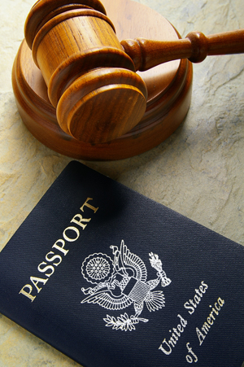
Implied Powers
Necessary and Proper Clause created the implied powers of congress.
This gives congress the power to make laws that will help them carry out their EXPRESSED powers.

Slide 10
Daily Grade: Option 1 and 2
1. Draw pictures to represent the expressed powers of congress we discussed above.
You should have at least 6!
Each picture should be labeled, described, and should represent the congressional power.
2. Section Reviews:
Question and Answer
Page 303: #2, #3, #4
Page 309: #2, #3, #4, #5

