Slide 1
Our Political Beginnings
August 18, 2015

Slide 2
Bell Ringer:August 18
What did the 3 philosophers have in common?
What were their contributions to political philosophy?

Slide 3
English Documents
Ideas of limited government, ordered government and representative government can be traced back to several landmark English documents.
The earliest was the Magna Carta.
A group of barons forced King John to sign in 1215.
This gave people the right to trial by jury and due process.
Only applied to upper class.
Meant the monarchs power was not absolute.

Slide 4
King John signs the Magna Carta

Slide 5
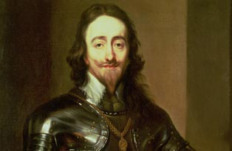
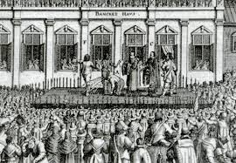
400 years later…
Many monarchs ignored the Magna Carta.
In 1628, Charles I wanted Parliament to raise taxes.
They refused until he signed the Petition of Right.
Further limited the kings power
King could no longer imprison people without a trial.
King could not impose military rule.
King could not force people to shelter troops.
Established the idea that even monarchs must obey the law of the land.

Slide 6
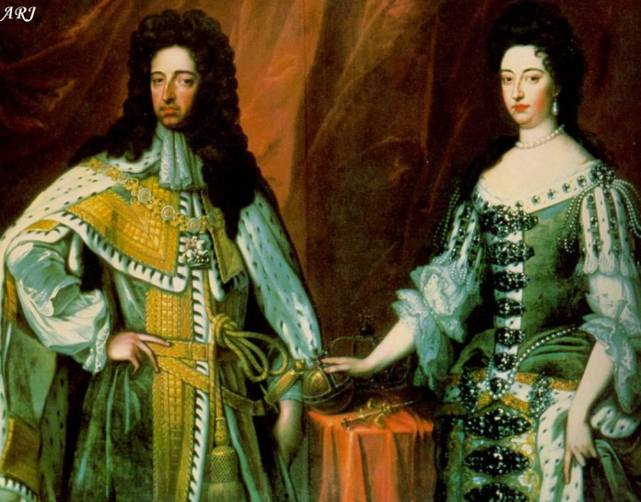
English Bill of Rights
After years of turmoil, William and Mary were offered the English crown by parliament.
In order to make sure no other monarch abused their power, Parliament made them sign the English Bill of Rights in 1689.
Prohibited standing army in peace time.
Required elections to be free.
People had the right to a fair trial
Freedom from excessive bail and cruel and unusual punishment.

Slide 7
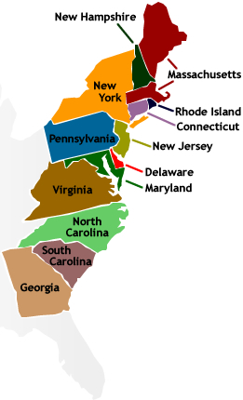
Colonial Era
Lasted about 170 years.
13 original colonies, created for different reasons.
Which was the last colony to be established?
___________________
3 types:
Royal Colony
Proprietary Colony
Charter Colony

Slide 8
Colonies
Royal Colonies: under direct control of the crown. There were 8. (Georgia was one)
Proprietary Colonies: There were 3. Organized by a proprietor (someone the king had granted land). The proprietor had control over these colonies.
Charter Colonies: A charter is a written grant of authority. These people were granted a charter by the king for different reasons. They were self-governing.

Slide 9
Crash Course American Revolution
https://www.youtube.com/watch?v=HlUiSBXQHCw

Slide 10
Timeline: Road to Independence
(pg 30-43)
Using your book create a timeline where each event explains how the colonists were pushed towards Independence from England.
Begin with the influence of philosophers and/or historic English documents and end with the Declaration of Independence.
Must have 8 events/people/documents
Must include explanations of event and it’s significance
Must include atleast 4 symbols or drawings related to events

