Slide 1
Judicial Branch
Introduction

Slide 2
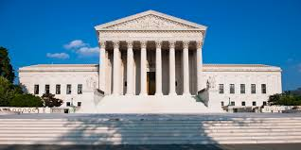
In the Constitution
Article III (3) created the Judicial Branch
The only court created was the Supreme Court
It is the shortest article in the Constitution.

Slide 3
2 Court System
We have two systems of courts in the United States:
Federal
State
Each state has it’s own court system based on its own constitution
Federalism!!!!

Slide 4
U.S. Supreme Court
State Courts
Federal Courts
State Supreme Courts
U.S Courts of Appeals
Intermediate Appeals Courts
U.S. District Courts
Trial Courts of General Jurisdiction
Trial Courts of Limited Jurisdiction

Slide 5
What is jurisdiction?
Which courts can hear what
Federal | State | Supreme Court
Cases involving federal law | Cases involving state law | All cases

Slide 6
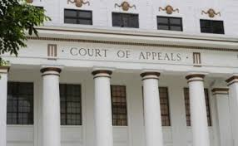
Trial vs. Appellate Courts
Trial Courts
Appeal Courts
Have the authority to hear a case first.
Original Jurisdiction
Above trial courts.
Review cases when they have been appealed
Options
Affirm: lets the decision stand.
Reverse: come to a new decision

Slide 7
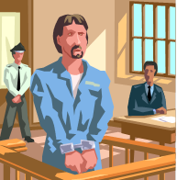
2 Types of Cases
Criminal: accused of a crime
Includes a prosecutor and a defendant
Civil: settles disputes/disagreements
Includes a plaintiff and a defendant

