Slide 1
Judicial Activism vs. Judicial Restraint

Slide 2
Judicial Philosophies **
Judicial Activism = liberal
Court should play active role in determining policies
Loose interpretation of Constitution
Should set precedents

Slide 3
Judicial Philosophies **
Judicial Restraint = conservative
Court should avoid political and social questions
Strict interpretation of Constitution
Should not seek to set precedents
** Conservative and liberal not set in stone for justices, necessarily.

Slide 4
Philosophy and Opinions
After decision is made, justices writes formal opinion
Explains decisions and how they voted
Issues of the case, precedents, guidelines for future cases
Three types:
Majority: decision of 5+
Concurring: voted with majority but for different reasons than majority opinion
Minority/Dissenting: vote against (4 or less)

Slide 5
Factors that Influence SCOTUS decisions
1. Precedents: stare decisis (let the decision stand)
most SCOTUS cases are based on precedents from earlier cases
Sometimes precedents are overturned
Example: Plessy v. Ferguson and Brown v. BOE

Slide 6
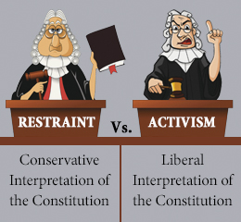
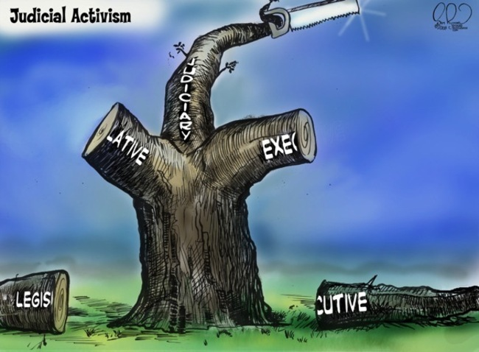
Factors that Influence SCOTUS decisions
2. Judicial Philosophy
Judicial Activism or Restraint?

Slide 7
Factors that Influence SCOTUS decisions
3. Public Opinion
Even though they are an Independent Branch
Appointed for life
Control own schedule (writ of cert)
Limited public access (no media, unless given permission)
They are still influenced…
Appointed and confirmed, so their decisions and ideology matter
Constitution can be amended
Congress can change jurisdiction
Congress can change number of justices
Justices can be impeached
Sensitive to important issues of the nation (in other words, they’re human too!)

