Slide 1
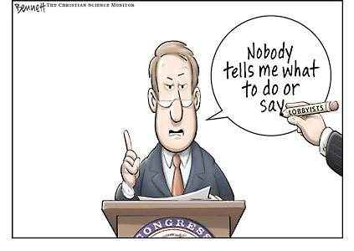
Interest Groups
Linkage Institutions

Slide 2
Interest Groups
Organized group of individuals seeking to influence the government and policies
*they operate at all levels of government (state and national)

Slide 3
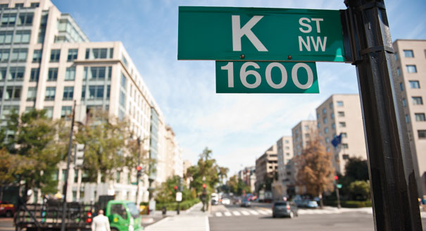
Lobbyist
Representative for an interest group

Slide 4
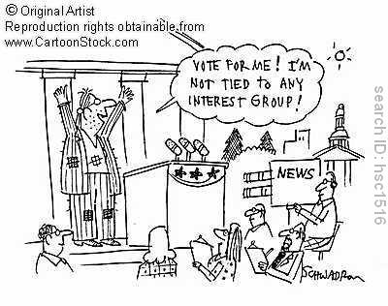
Functions of Interest Groups

Slide 5
Representation
Serves as a link between government and the people

Slide 6
Education
Increase people’s awareness and interest
Educate government with data to make good policies

Slide 7
Participation
People work together for a common goal

Slide 8
Agenda building
Bring issues to public and government attention
Make sure something is done to fix issues

Slide 9
Program Monitoring
Keep track of government programs that are important to the group’s goals

Slide 10
In your own words …
What is the function of interest groups in our government?
In other words, what do they do?

Slide 11
Why do interest groups form?
Remember Federalist No. 10?? – Madison says factions are undesirable but inevitable
Why? People naturally group together to address concerns, interests, etc.

Slide 12
How do interest groups link the government to the people?
Express members’ desires to elected officials
Convey government policy plans to the people
Raise and spend money to influence government officials

Slide 13
How are interest groups different from political parties?
Parties: ELECT individuals to office, focus on broad topics and are accountable to all people
Interest Groups: INFLUENCE elected officials, focus on one topic, and are accountable only to members (private organization)

Slide 14
Types of Interest Groups
Economic Interest: primary purpose is to promote the financial interests of its members
Business
Labor
Professional
Agricultural

Slide 15
Business
Companies have interest groups monitor legislation that may impact business
Examples: Chamber of Commerce, NAM (National Association of Manufacturers)

Slide 16
Labor
Union organizations that represent worker’s rights
Examples: AFL-CIO (American Federation of Labor – Congress of Industry Organization)

Slide 17
Professional
Membership based on job
Examples: NEA (educators), AMA (medical), ABA (American Bar Association – lawyers)

Slide 18
Agricultural
Shape agricultural/farming policies EX: National Farmers Union, Farm Bureau

Slide 19
Types of Interest Groups:
Public Interest – wants collective good that doesn’t focus on benefitting just one group of people
Environmental
Equality
Single-issue

Slide 20
Environmental
wilderness protection, pollution, animal rights, no offshore drilling, etc.
Ex: PETA, WWF (World Wildlife Federation) and Sierra Club

Slide 21
Equality
Equal rights for minority groups
Ex: NOW, NAACP, VFW and AARP

Slide 22
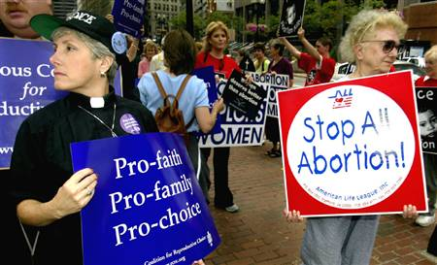
Single-Issue
Focus on one issue (instead of a group of people)
Ex: Planned Parenthood, NRA

Slide 23
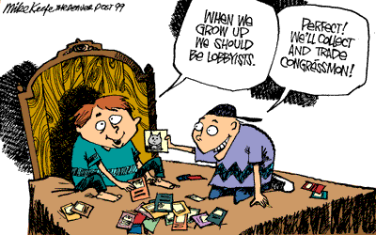
Strategies
What do interest groups do?

Slide 24
Influencing elections/electioneering
Campaign contributions (amount is limited per candidate → PACs)
Grassroots efforts
Public awareness

Slide 25
Litigation
Take issues to court if Congress won’t support (example: NAACP supports Brown v. Board case because Congress wasn’t moving forward on segregation legislation)
Class-action suit: people combine lawsuits into 1 stronger case
Amicus curiae brief – legal document by “friend of the court” supporting 1 side of a case

Slide 26
Going public:
Appeal to the people for support
Raise awareness of issues
Raise money through PACs
PACs are formed by interest groups to raise money for campaign or candidate

Slide 27
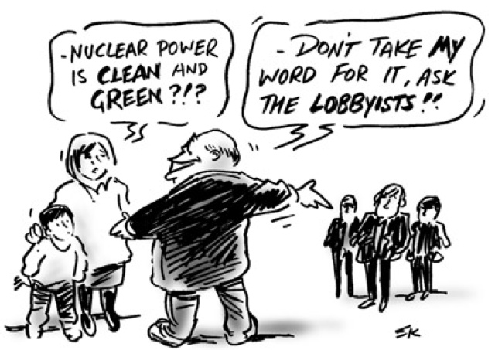
Lobbying **
Try to influence the government (policymakers) by providing information and data

Slide 28
Direct Lobbying: use of personal contact
Congress – many lobbyists were Congressmen and have friends in Congress
Executive – provide decision makers at all levels with information to help implement laws
Judicial – litigation, amicus curiae briefs (cannot directly “lobby” judges, would be improper)

Slide 29
Grassroots Lobbying
“the people back home”
Write letters, emails, fax, phone calls, petitions to representatives/senators

Slide 30
Coalition Lobbying
Several groups join together for a common goal

Slide 31
Protest/radical lobbying
Use force to bring attention to a cause
Examples: PETA (red paint or “blood” of fur worn by celebrities), Civil Rights groups (sit-ins, protest marches, etc.)

Slide 32
What is lobbying?
With your elbow partner, come up with 3 characteristics of lobbying. Be prepared to share!

Slide 33
What makes interest groups successful?
Size
Leaders
Intensity
Money

Slide 34
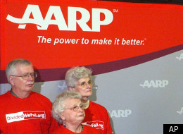
Size
More people = more calls, emails, campaign work and bigger protests
BUT more people can lead to conflict AND free-rider problem
Free-rider – people who benefit from work of the group without doing any work

Slide 35
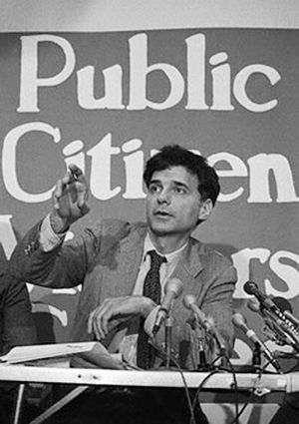
Leaders
Strong, charismatic leaders find a way to attract members and are persuasive about importance of issues

Slide 36
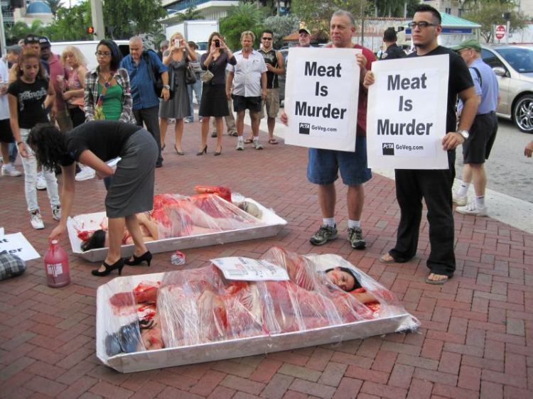
Intensity
The more passionate the members are about a cause the more effort they will put into the group

Slide 37
Money
Groups need funding to hire lobbyists, support PACs, write amicus curiae briefs and other activities
More money can make up for less passion from members

