Slide 1
Impeachment

Slide 2
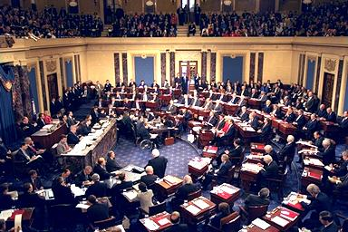
Impeachment
The Constitution provides that the President, Vice President, and all civil officers “may be removed from Office on Impeachment for and Conviction of Treason, Bribery, and other high crimes”.

Slide 3
Congressional Power
The House has the sole power to impeach.
The JUDICIARY committee brings the charges.
This requires a MAJORITY votes
Impeach simply means to accuse or bring charges.
The Senate has the power to judge (act as a court) during impeachment trials.
To be removed from office the senate must have a 2/3rds vote
The Chief Justice presides over the Senate during impeachment trials

Slide 4
Judges
So far the only 8 men have been found guilty during an impeachment trial and these were all Federal Judges.
There have been 19 total impeachment cases.
Two presidents have been impeached by the house but neither president was found guilty by the Senate.

Slide 5
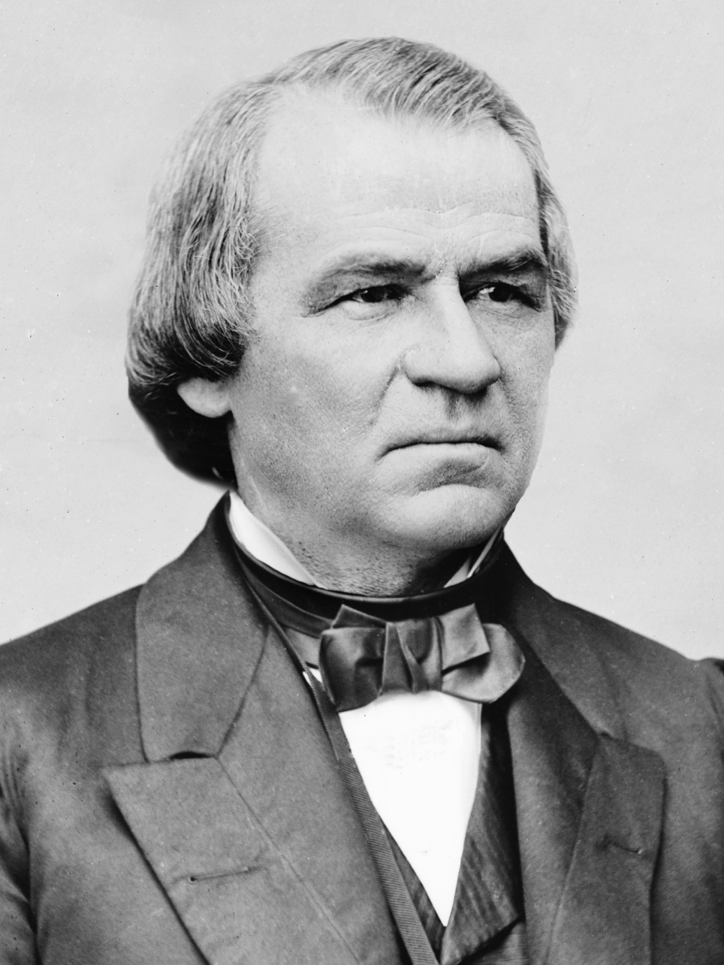
Andrew Johnson: 17th President
Johnson was Abraham Lincoln’s Vice President.
He was president after the Civil War during the Reconstruction of the South.
How do you think Andrew Johnson became president?

Slide 6
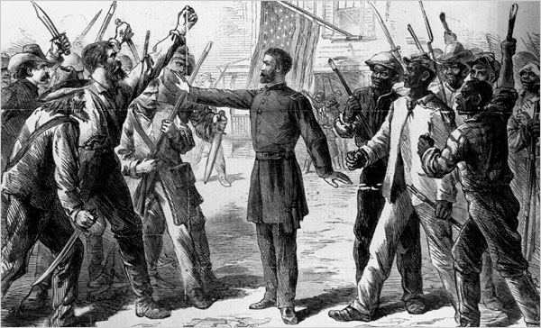
President vs. Congress
Johnson and Congress had different ideas of how the South should be “reconstructed”.
Johnson did not believe in harsh punishment for the Southern States while Congress (mostly Radical Republicans) thought the South should pay for tearing apart the nation.

Slide 7
Tenure of Office Act 1867
Created to limit the power of Johnson.
Stated he couldn’t remove executive officers without the Senate’s approval.
Johnson vetoed this act, Congress overrode the veto but the president violated the act anyways.

Slide 8
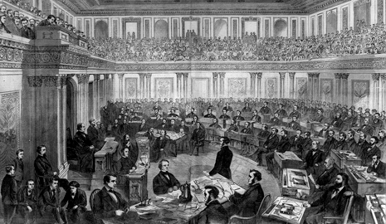
Johnson’s Trial
Johnson was impeached by the house but he was NOT removed from office by the Senate.
The senate fell short of impeachment by just ONE vote.

Slide 9
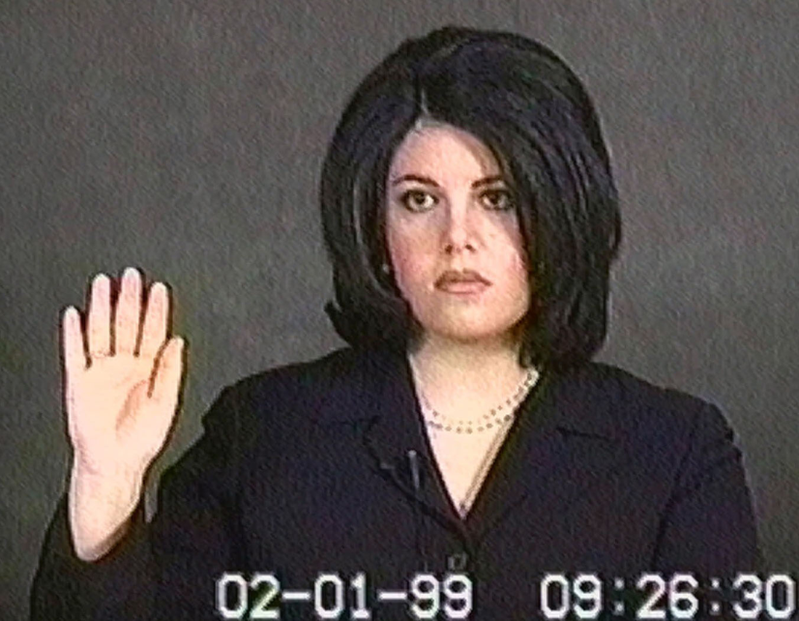
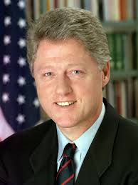
Bill Clinton
Clinton was impeached by the House in 1998, this arose from an inappropriate relationship the president had with a White House intern.
Remarks after the House
He was accused of perjury and obstruction of justice
Perjury: Lying under oath
Obstruction of Justice: withholding information from the courts

Slide 10
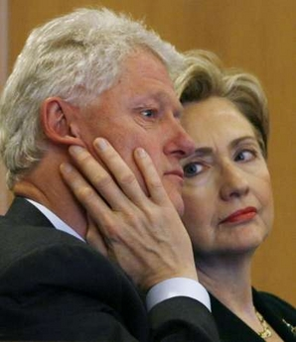
Bill on Trial
Bill was acquitted of both accusations.
The majority of Congress agreed that what Clinton did was unethical but it wasn’t reason for impeachment.
Final Remarks

Slide 11
Quick Quiz
Who has the power to impeach the president?
Who has the power to how the impeachment trial?
How many president’s have been impeached?
How many president’s have been removed from office?

