Slide 1
Introduction to Government

Slide 2
Government and Public Policy
Government: an institution through which a society makes and enforces public policies.
Public Policies: all things a government decides to do.
Examples of Public Policies:
1.
2.
3.
4.

Slide 3
POWER
The government does not function without power.
3 Basic Powers:
Legislative: power to MAKE LAWS
Executive: power to EXECUTE/ENFORCE laws
Judicial: power to INTERPRET LAWS
These powers are described in a country’s constitution.
The responsibility for this power could be held by one person, or a few people.
OR there could be a democracy.
Democracy: power is in the hands of the people.

Slide 4
What is politics?
Politics and government are different things.
Politics is a process.
How will power be distributed?
How will resources be distributed?
Who will benefit?
Who will pay the cost?
Politics is simply how a government conducts itself.

Slide 5
Characteristics of a STATE
The “state” is a political unit.
Every state has 4 characteristics:
Population: must have people!
Territory: must have recognized boundaries!
Sovereignty: must have power within it’s territory!
Government: must have government to enforce it’s policies!

Slide 6
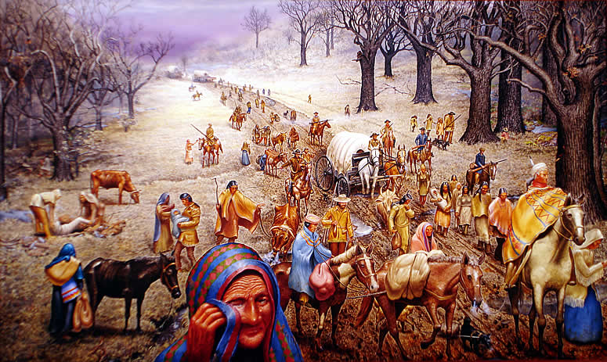
How were “states” created?!?!
The Force Theory: States were born from force.
This means a person, or group of people came into an area, took control of it, and forced everyone there to follow their rules.

Slide 7
The Evolutionary Theory
Evolution: the process of development
Evolutionary Theory:
States developed naturally out of the early family. There was a family, then a group of families (clan) turned into a tribe, once they established themselves in one place… BOOM! The first state!
How can a family be like a tiny government?
___________________________________

Slide 8
The Divine Right Theory
Divine: coming from GOD
Divine Right Theory: People believe that God created the state and God gave those of royal birth a “divine right” to rule.
People must obey their ruler like they would obey God.
Disobeying=Sinning.
Present day government’s exist because people began to challenge this theory.
What is democracy again? ____________________________________

Slide 9
The Social Contract Theory
Social: relating to people
Contract: written or spoken agreement
Social Contract Theory:
A long time ago everyone had complete freedom. People lived in a “state of nature”.
What could be a problem?_________________________
Who would survive in this society?___________________
So humans agreed to create a STATE. They created a contract, gave up some of their powers and in return the state would offer protection to the people.

Slide 10
Closing Reflection: Daily Grade
Separate sheet of paper.
Draw an illustration/cartoon demonstrating your understanding of each theory.
Explain your illustration in a short sentence.
Force Theory: | Divine Right Theory:
Evolutionary Theory: | Social Contract Theory:

Slide 11
The Purpose of Government
Chapter 1 (Section 1)
Bell Ringer: Poll!
Write down: What is the Purpose of government?
You have 10 minutes to tour the school asking teachers, Students, Admin, or other faculty to answer this question for you.

Slide 12
What does the Constitution say?

Slide 13
SIMPLIFY
“form a more perfect Union”
“establish justice”
“insure domestic tranquility”
“provide for the common defense”
“promote the general welfare”
“secure the blessings of liberty to ourselves and our posterity”

