Slide 1
Federalism
Give an Example of A check and Balance for Each branch:

Slide 2
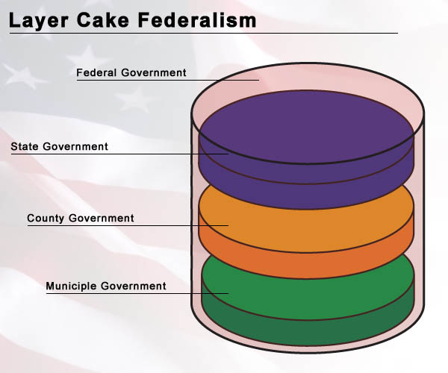
Federalism
A system of government where power is divided between national and state governments.
Our national government has powers and the 50 states have power.
This allows for states to create their own laws and experiment with public policy.

Slide 3
Delegated (granted) Power
Delegated Powers are powers that are granted in the Constitution.
Our National/Central/Federal government has delegated powers.
3 Types:
Expressed Powers: spelled out in the constitution.
Implied Powers: Not spelled out but reasonably suggested.
Necessary and Proper Clause
Inherent Powers: powers that all national governments have come to possess.

Slide 4
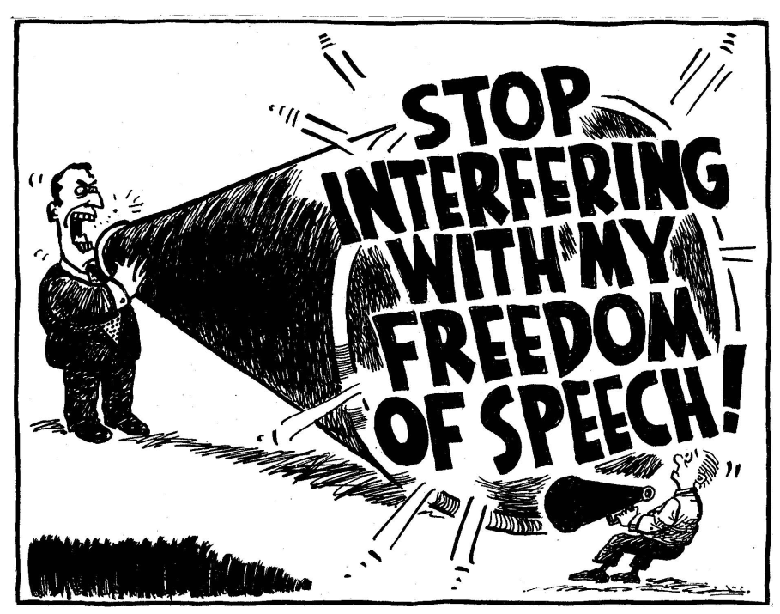
Power Denied to the Federal Government
Expressly: can’t prohibit freedom of speech, conduct illegal searches, deny a person of a fair and speedy trial.
Other silent denied powers include: cant create public school system for the nation, uniform marriage and divorce laws

Slide 5
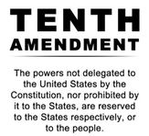
State Powers
Reserved Powers: The powers not granted to the national government, nor denied to the state governments are reserved for the state.
Most of what the government does today is done by the states, through reserved powers.
Powers denied to the state include: power to print money, sign treaties, create confederations.

Slide 6
Exclusive and Concurrent Powers
Exclusive powers can only be exercised by the National Government.
Most are expressly denied to the states (coining money)
Concurrent powers are shared between state and the national government.
These powers happen separately and simultaneously between the two levels of governments.
Example: establish courts

Slide 7
Supremacy Clause
Since our government functions at two levels and governs the same people, our framers were worried there would be issues.
The US Constitution and our federal/national/central government’s laws and treaties are the SUPREME LAW OF THE LAND.

Slide 8
Daily Grade
Look through your book pgs. 94-101
Find an example of each power we discussed.
Expresssed, Implied, Inherent, Reserved, Exclusive, and Concurrent.
Turn in your work from yesterday, illustrations of each Principle of the Constitution.
Vocabulary due day of test.

