Slide 1
What is a Crime??
Definition:
Examples:

Slide 2
Criminal vs. Civil Trial
Criminal
Civil
Parties Involved: Prosecutor (government) and Defendant
An individual is accused of breaking the law.
Burden of Proof: Jury must be convinced BEYOND A REASONABLE DOUBT.
Result: Probation, fines, time in prison
Examples:
Parties Involved: Plaintiff (brings charges) and Defendant.
Two individuals cannot come to an agreement.
Burden of Proof: Preponderance of evidence must be provided by the plaintiff.
Result: $$$$ rewarded to Plaintiff
Examples:

Slide 3
Process in Criminal Justice
Crime is committed
Arrest
Pre-Trial
Grand Jury (if a major crime)
Indictment
Trial
Possible Plea Bargain
Arraignment
Jury Selection
Jury deliberation
Sentencing
Appeals
Incarceration (Release after sentence is served or parole)

Slide 4
Types of Crimes
Status Offense: misbehavior by children under 18
Petty Offense: lowest level of criminal offense, handled at municipal court, possibly no trial
Examples:
Misdemeanor: mid level offenses, fined or spend time in jail
Examples:
Felony: crimes punishable by prison of 1 year+, life in prison, or death in Georgia
Examples:

Slide 5
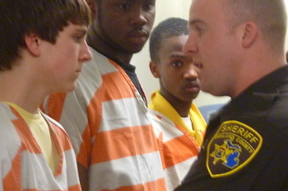
Why commit a crime?
Mental Instability
Need/Desire to commit the crime
Societal Influences
Lack of Education
Poverty
Peer Pressure

Slide 6
Consequences
Victim
Person committing the Crime
Injury
Psychological effects
loss
Community service
Incarceration
Loss of rights
Fines

